Slide 1
Bright Coffee Shop
Business Analysis
PREPARED FOR: CEO
PRESENTED BY: MICHELLE ZIJENA

Slide 2
OBJECTIVE
FIND WAYS TO GROW COMPANY REVENUE
IMPROVE PRODUCT PERFORMANCE

Slide 3
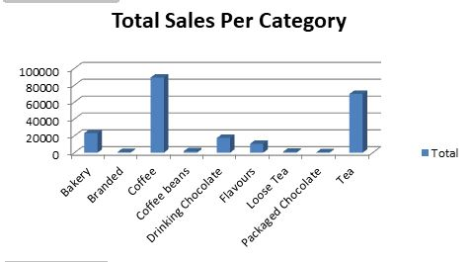
KEY INSIGHTS
TOTAL SALES PER CATEGORY
COFFEE AND TEA BRING THE MOST REVENUE
PACKAGED CHOCOLATE, LOOSE TEA AND BRANDED ITEMS BRING THE LEAST REVENUE

Slide 4
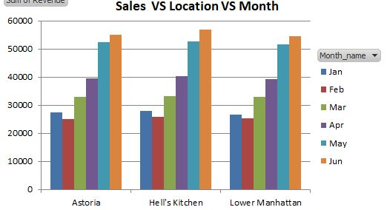
REVENUE PER LOCATION AND MONTH
ALL 3 STORE LOCATIONS GENERATE THE MOST REVENUE IN THE MONTHS OF APRIL, MAY & JUNE
LEAST PERFORMING MONTHS FOR ALL 3 STORES IS FEBRUARY

Slide 5
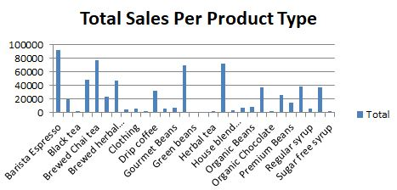
REVENUE PER PRODUCT TYPE
MOST SOLD PRODUCT TYPE IS THE BARISTA ESPRESSO AS WELL AS VARIOUS HERBAL TEAS
LEAST SOLD PRODUCT TYPE IS THE GREEN BEANS AND ORGANIC CHOCOLATE

Slide 6
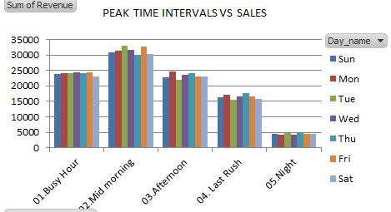
PEAK TIME INTERVALS VS REVENUE
MORNING, MID MORNING AND AFTERNOON ARE PEAK TIME INTERVALS THAT GENERATE THE MOST REVENUE
THE NIGHT TIME INTERVAL GENERATES THE LEAST RVENUE
PEAK DAYS ARE TUESDAYS AND FRIDAYS IN WHICH MOST REVENUE IS MADE

Slide 7
RECOMMENDATIONS
MARKETING CAMPAIGNS DURING SLOW TIME SLOTS
STOCK MORE OF THE BEST-SELLING PRODUCTS
PROMOTE UNDERPERFORMING PRODUCTS

Slide 8
NEXT STEPS
AUTOMATE DAILY SALES REPORTING
TRACK SALES PERFORMANCE ACROSS MULTIPLE LOCATIONS IN THE FUTURE
IMPLEMENT LOYALTY PROGRAMS BASED ON PEAK CUSTOMER TIME SLOTS

Slide 9
THANK YOU.

